Slide 1
The Delaware Study
Best Practices for Managing Costs and Productivity
Allison M. Walters
awalters@udel.edu
Assistant Director
Office of Institutional Research
University of Delaware
Data Manager
Delaware Study of Instructional Costs & Productivity

Slide 2
Outline
Delaware Study’s utility as a management tool
What we know about comparing costs
Examples of best practices

Slide 3
2011 Inside Higher Ed Survey of College and Univ Presidents
Top two challenges:
Publics: budget shortfalls (62%), changes in state support (43%)
Privates: rising tuition/affordability (42%), increased competition for students (35%)
Notes:
I am cognizant of a few things:
Your need to rely on data – MSCHE
Need for rich and varied data sources
Navigate current fiscal climate
Humanities program cuts – Languages, Theater SUNY Albany. Classics/Latin, German, Perf Arts Centenary C. of Louisiana
Lang at U NV Reno,
Phil is under review at IUP,
Other majors with low enrollments – physics at Centenary C. of Louisiana.
2011 Inside Higher Ed Survey of College and Univ Presidents
UWIMad - $20M grant for humanities

Slide 4
2011 Inside Higher Ed Survey of College and Univ Presidents (cont.)
Response:
Public Doctoral: cuts to select academic programs (71%), laid off administrators (59%), increased tuition (59%) and fees (48%)
Private Masters & Bacc: about half report tuition discount rates have increased as they’ve provided more financial aid to offset their higher tuitions.
Notes:
Criticism is that you can’t use the same strategies as in the past when things “got better”
Leads to question of whether the response necessary is to adapt to permanent shift in higher ed financing with more drastic changes
partnerships with other colleges
develop or broaden online programs
re-evaluate tenure - pressure to retire at Lyndon State College (VT)
employee benefits
Certainly cannot claim that there is a simple answer that will apply to every institution.
Also cannot claim that the Delaware Study provides a “magic bullet” in dealing with fiscal decisions.

Slide 5
The Delaware Study
~180-200 annual participants
Benchmark teaching activity, instructional costs, and externally funded faculty scholarship, all at the discipline level
Carnegie classification
Highest degree
Relative emphasis of undergraduate v. graduate instruction
Notes:
Certainly cannot claim that there is a simple answer that will apply to every institution.
Also cannot claim that the Delaware Study provides a “magic bullet” in dealing with fiscal decisions.

Slide 6
2009 Delaware Study Participants
 | Public | Private
Research | 58 | 3
Doctoral | 10 | 1
Comprehensive | 48 | 28
Baccalaureate | 10 | 16
 | 126 | 48
States: UNC, PA, Univ of Nebraska, Univ of Missouri
Groups: AAUDE, SUG

Slide 7
The Delaware Study as a Management Tool
To assess the relative position of academic departments and programs in relation to those at appropriate comparator institutions.
Not intended to be used as a tool to reward or penalize programs, but rather to focus on strategies for program improvement.
Understand – Compare – Evaluate Resources
Notes:
could make cuts
We recommend that you use data to reallocate resources, streamline efficiency of depts

Slide 8
Science Department

Slide 9
Teaching Load Data

Slide 10
More Teaching Load Data

Slide 11
Cost & Scholarly Productivity Data

Slide 12
Direct Instructional Costs
85% to 90% (on average) driven by faculty salaries.
Tenured and tenure-track faculty are “fixed costs.”
Difference in cost among institutions is due to the disciplines that comprise the curriculum within the institutions.
Middaugh, M.F., Graham, R., & Shahid, A. (2003). A Study of Higher Education Instructional Expenditures: The Delaware Study of Instructional Costs and Productivity (NCES 2003-161). Washington, DC: U.S. Department of Education.
Notes:
DIE make up 50-75% of operating budget at most 4 year institutions.
Most of the variance in cost is explained by the disciplines that comprise the curriculum of an institution, ranging from 76 to 83%.

Slide 13
Direct Expense per Student Credit Hour Taught: Institution Type Within Discipline, 2007

Slide 14
Direct Expense per Student Credit Hour Taught: Discipline Within Institution Type, 2007

Slide 15
Cost Factors
Volume of teaching activity. Cost decreases as volume increases.
Department size. The larger the department, the higher the cost.
The proportion of faculty holding tenure. The higher the proportion of tenured faculty, the higher the cost.
The presence of graduate instruction increases costs.
Middaugh, M.F., Graham, R., & Shahid, A. (2003). A Study of Higher Education Instructional Expenditures: The Delaware Study of Instructional Costs and Productivity (NCES 2003-161). Washington, DC: U.S. Department of Education.
Notes:
60 to 75 % of the variation in cost within a discipline across institutions is associated with specific cost factors:
Volume of teaching activity, as measured by total student credit hours taught, is a major factor. Cost decreases as volume increases.
Department size, as measured in terms of total number of faculty, is a consistent cost indicator. The larger the department, the higher the cost.
The proportion of faculty holding tenure is a cost factor. The higher the proportion of tenured faculty, the higher the cost.
The presence of graduate instruction in a discipline increases costs, although the measured effect of this variable on direct instructional expense in this study is smaller than teaching volume, department size, and faculty tenure rate.

Slide 16
Examples of Best Practices

Slide 17
University of Mississippi
 |  | Dept X | SUG Benchmark
Total FTE Instructional Faculty |  | 21.5 | 40.78
% T/TT Inst. FTE Faculty |  | 60% | 49%
% Ugrad SCH Taught by T/TT Faculty FTE (Instructional) |  | 55% | 48%
% Grad SCH Taught by T/TT Faculty FTE (Instructional) |  | 100% | 92%
% Ugrad SCH Taught by TA's (Credit-Bearing) |  | 8% | 15%
Total SCH per ALL Faculty FTE (Instructional) |  | 243 | 181
FTE Students Taught per T/TT Faculty FTE (Instructional) |  | 21.3 | 8.9
FTE Students Taught per ALL Faculty FTE (Instructional) |  | 16.2 | 11.9
Sections per Instructional T/TT Faculty FTE (Incl. Labs) |  | 4 | 2.8
Sections per ALL Instructional Faculty FTE (Incl. Labs) |  | 4.3 | 2.7
Notes:
Use when faculty ask for addt’l lines
More T/TT faculty
More productive

Slide 18
University of Mississippi (cont.)
 |  | Dept X | SUG Benchmark
Salary/Benefits as % of Total Budget |  | 93% | 90%
Expenditure per SCH |  | $162 | $229
Expenditure per FTE Student |  | $4,826 | $6,751
Notes:
Efficient use of resources

Slide 19
New Mexico State University
Key variables
SCH/FTE faculty
Cost/SCH
Comparators
Carnegie Research Class
Land-Grants
Departmental Budget Metrics
Strategic Planning
Academic Program Review
Notes:
Monitor use of supplemental faculty – to use fewer resources
Reallocate funds when faculty line opens
Monitor peers and their trends
Load data into warehouse – IPEDS for E&G, APPA for Facilities, Educause for IT,
Tell good stories to the state

Slide 20
University of Colorado – Boulder
http://www.colorado.edu/pba/course/delaware/ovv.htm
Compare Colorado data
to AAU
To individual Colorado disciplines
Notes:
Load Excel files to website.
Available by request.

Slide 21
University of North Carolina System
Board of Governors monitors faculty teaching loads
Faculty Teaching Workload Report
Notes:
to provide information to the CAO’s to manage their loads equitably and efficiently
Managed best at dept and school level
Generate annual Faculty Teaching Workload Report
Sections taught, SCH taught by level
M= w/in 1 SD nat norm
B= > 1 SD nat norm
Invite response by schools and plans for improvement
Track trend in students taught and SCH per instructor for the system. Budget downturn = Higher workload.

Slide 22
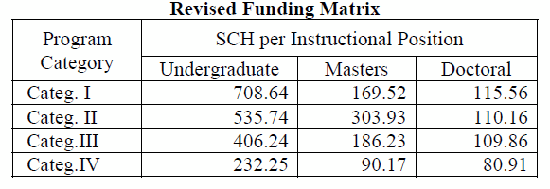
University of North Carolina System (cont.)
Number of SCH within category to generate one additional faculty FTE.
Category I: English, History, Math
Category II: Business, Education, Foreign Languages
Category III: Ag, Physical Sciences, Public Admin, Visual and Perf. Arts
Category IV: Nursing and Engineering
Notes:
Delaware Study is data source for Enrollment Funding Model.
Undergraduate requires most SCH, (higher workload)
Category 1 least expensive per SCH.
The comparison between the values in the original matrix and the revised matrix demonstrate that the expected productivity of faculty has
increased, particularly for undergraduate instruction – the largest volume of instruction for UNC institutions.

Slide 23
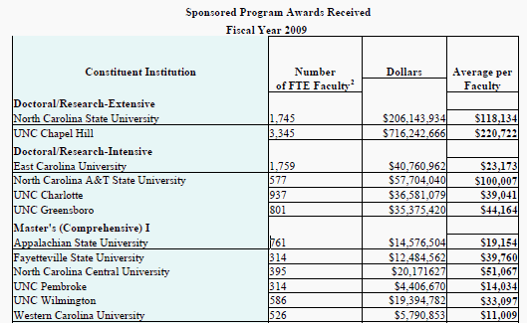
University of North Carolina System (cont.)
Notes:
Commitment to public good

Slide 24
Montana State University
Allocation of new faculty lines
Doing “more with less”
Notes:
Decide whether to allocate new faculty line to a requesting department
Deans can show funders and advisory boards how productive they are with few resources

Slide 25
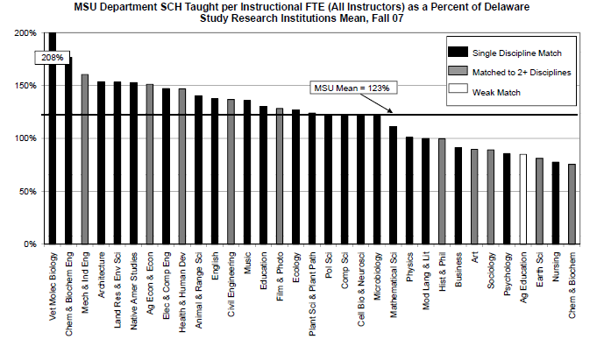

Slide 26
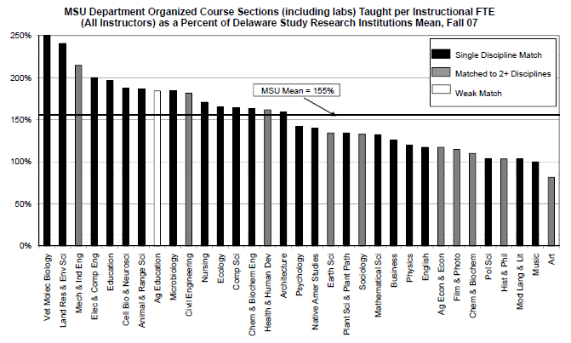

Slide 27
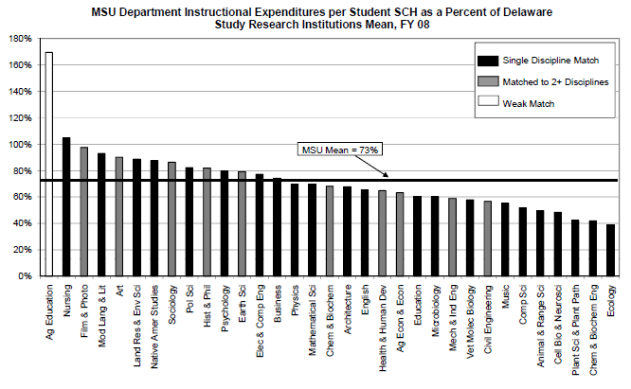

Slide 28
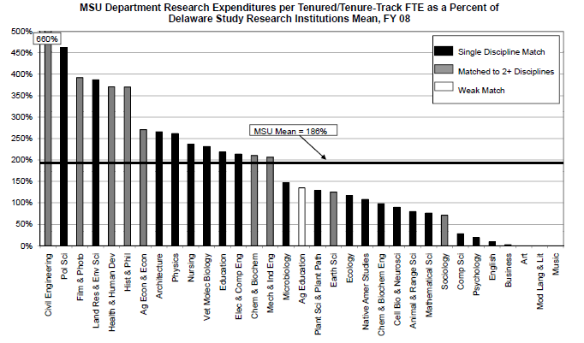

Slide 29
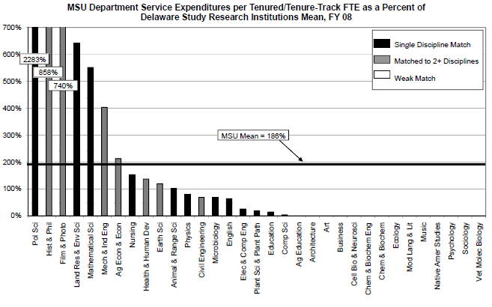

Slide 30
University of West Georgia
Group departments by level of teaching activity and cost

Slide 31
UWG: Total SCH per FTE Faculty (All Categories)
Notes:
11 out of 18 taught more SCH in 2007 than in 2005
1’s are internally comparable

Slide 32
UWG: Total SCH Taught Per Faculty FTE (All Categories) - UWG as % of Comprehensive Universities & Colleges

Slide 33
UWG: Direct Instructional Expenditures per SCH

Slide 34
UWG: Direct Instructional Expenditures per SCH - UWG as % of Comprehensive Universities and Colleges
Notes:
Most are at or below norm
Lowest may be underfunded, or teaching loads too high

Slide 35
UWG: Classification of Faculty Teaching Loads & Instructional Expenditures by Department
 |  | Direct Instructional Expenditures
 |  | Low | Moderate | High
Teaching Loads | Low |  | Dept. PY3 | Dept. NN1 Dept. PS1
 | Moderate | Dept. AT2 Dept. CC1 | Dept. EE3 Dept. PL3 Dept. SY3 | Dept. PH2
 | High | Dept. AP3; Dept. BY1; Dept. CP1; Dept. GS1 Dept. HS3; Dept. CM3 Dept. MA3; Dept. PP3 | Dept. MM2
Notes:
Avg the two year’s data
Split teaching load and cost into thirds
Upper right: look into the quality – research, nature of program. have to justify why they need more money
Middle top: can an increase in teaching load make better use of their resources?
Lower left: what is the trade off, if any? They may need more funding to stabilize their workload.

Slide 36
Allison M. Walters
Assistant Director, Office of Institutional Research, University of Delaware
Data Manager, Delaware Study of Instructional Costs & Productivity
awalters@udel.edu
302-831-2021

